Slide 1
Attention! Attention
или
Внимание! Внимание)
by metya

Slide 2
Disclaimer
Almost all content from this presentation has been impudently stolen from well-known sources.
All links to the desecrated sources will be at the end.
But all needed original sources will be in footnotes.
There is a lot of formulae so
Pay ATTENTION.
Lol.

Slide 3
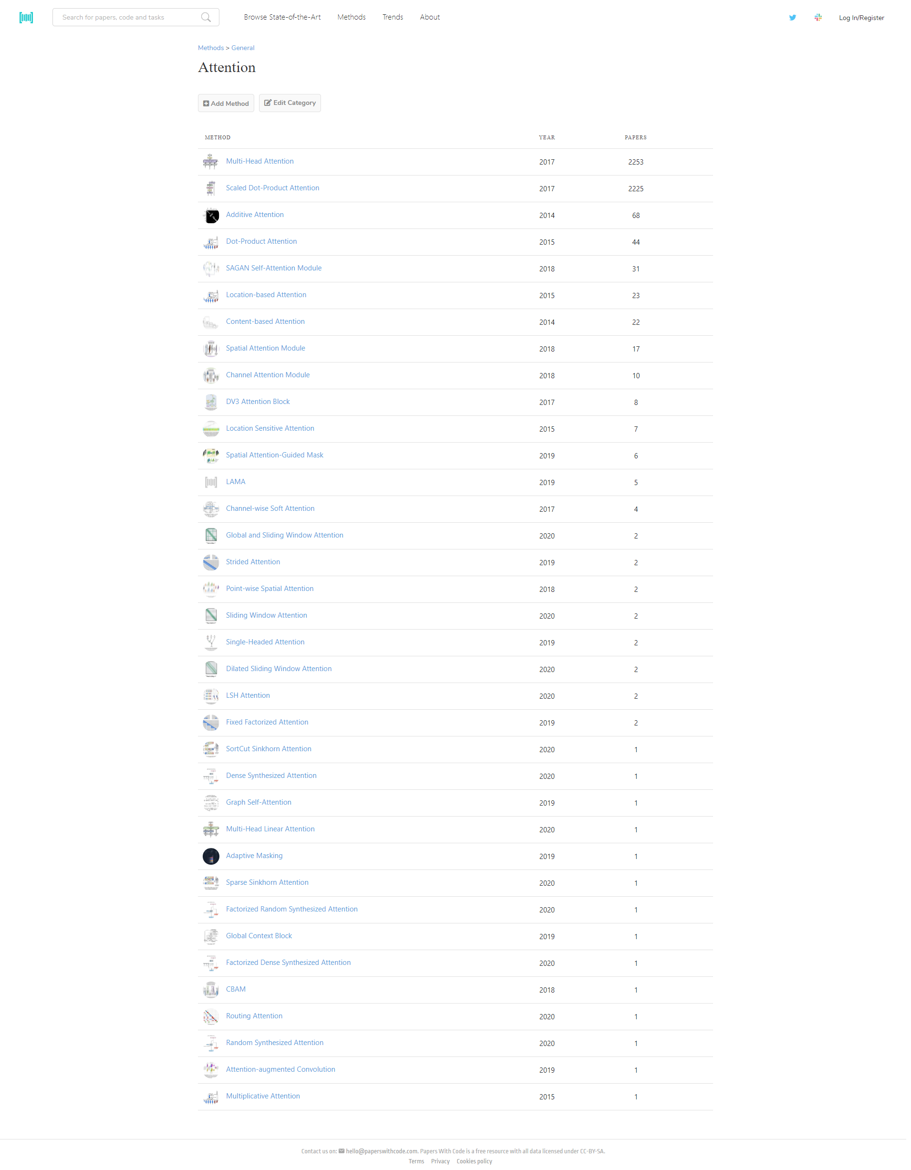
What to know paperswithcode about attention?

Slide 4
Where the legs grow from
Machine Translation!
But you know it already, right?
So it’s about seq2seq for translation task, but a little augmented.

Slide 5
Tags, Sections, Whatever
Attention
Self-Attention
Other types of attention
Some applications on some other fields, not only text
Modern Attention and esoteric maybe.

Slide 6
Attention
Global/Local
Hard/Soft
Other types like dot product))))0))0

Slide 7
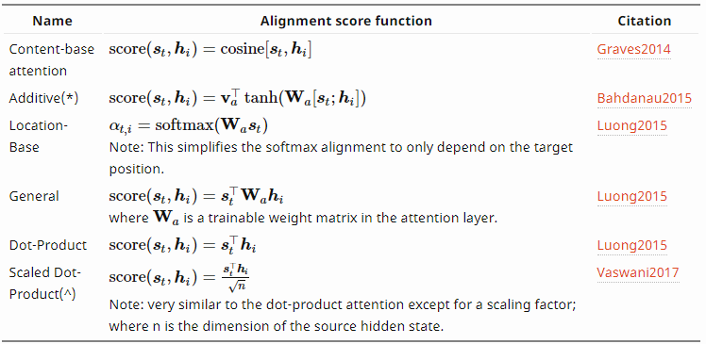
So attention, ha?
Neural Machine Translation By Jointly Learning To Align And Translate. Dzmitry Bahdanau. et al 14
Effective Approaches to Attention-based Neural Machine Translation. Minh-Thang Luong et al 15
Attention Is All You Need. Ashish Vaswani et al. 17

Slide 8
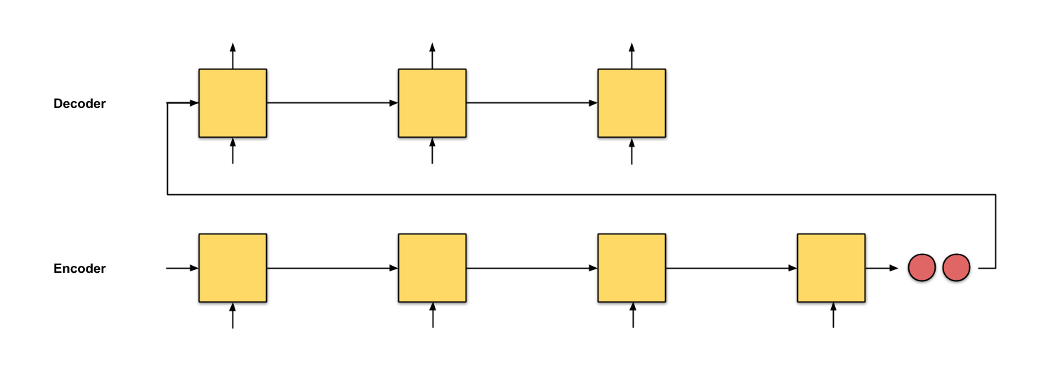
Seq2seq

Slide 9
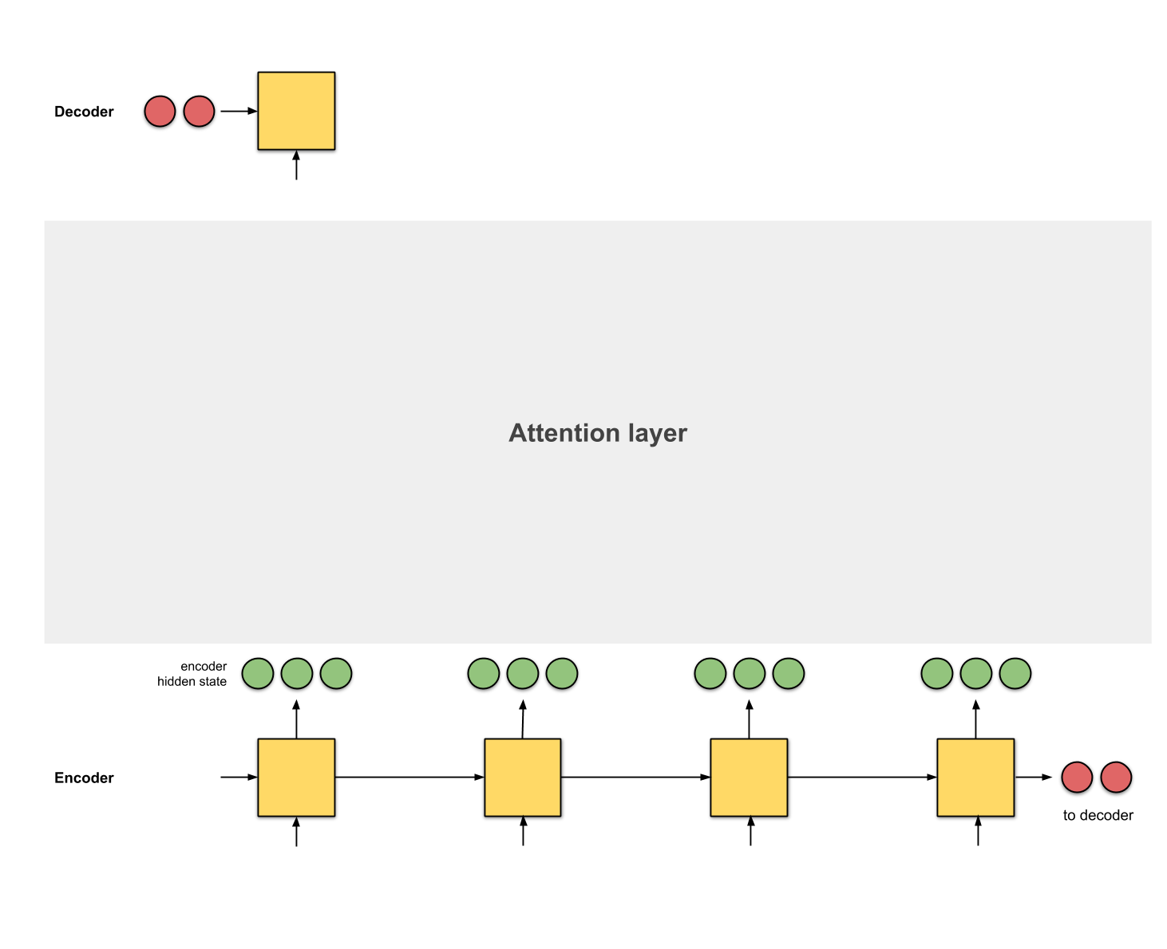
Seq2seq + attention

Slide 10
Aligner
In fact in paper it calls alignment model
alignment means matching segments of original text with their corresponding segments of the translation.

Slide 11


Slide 12
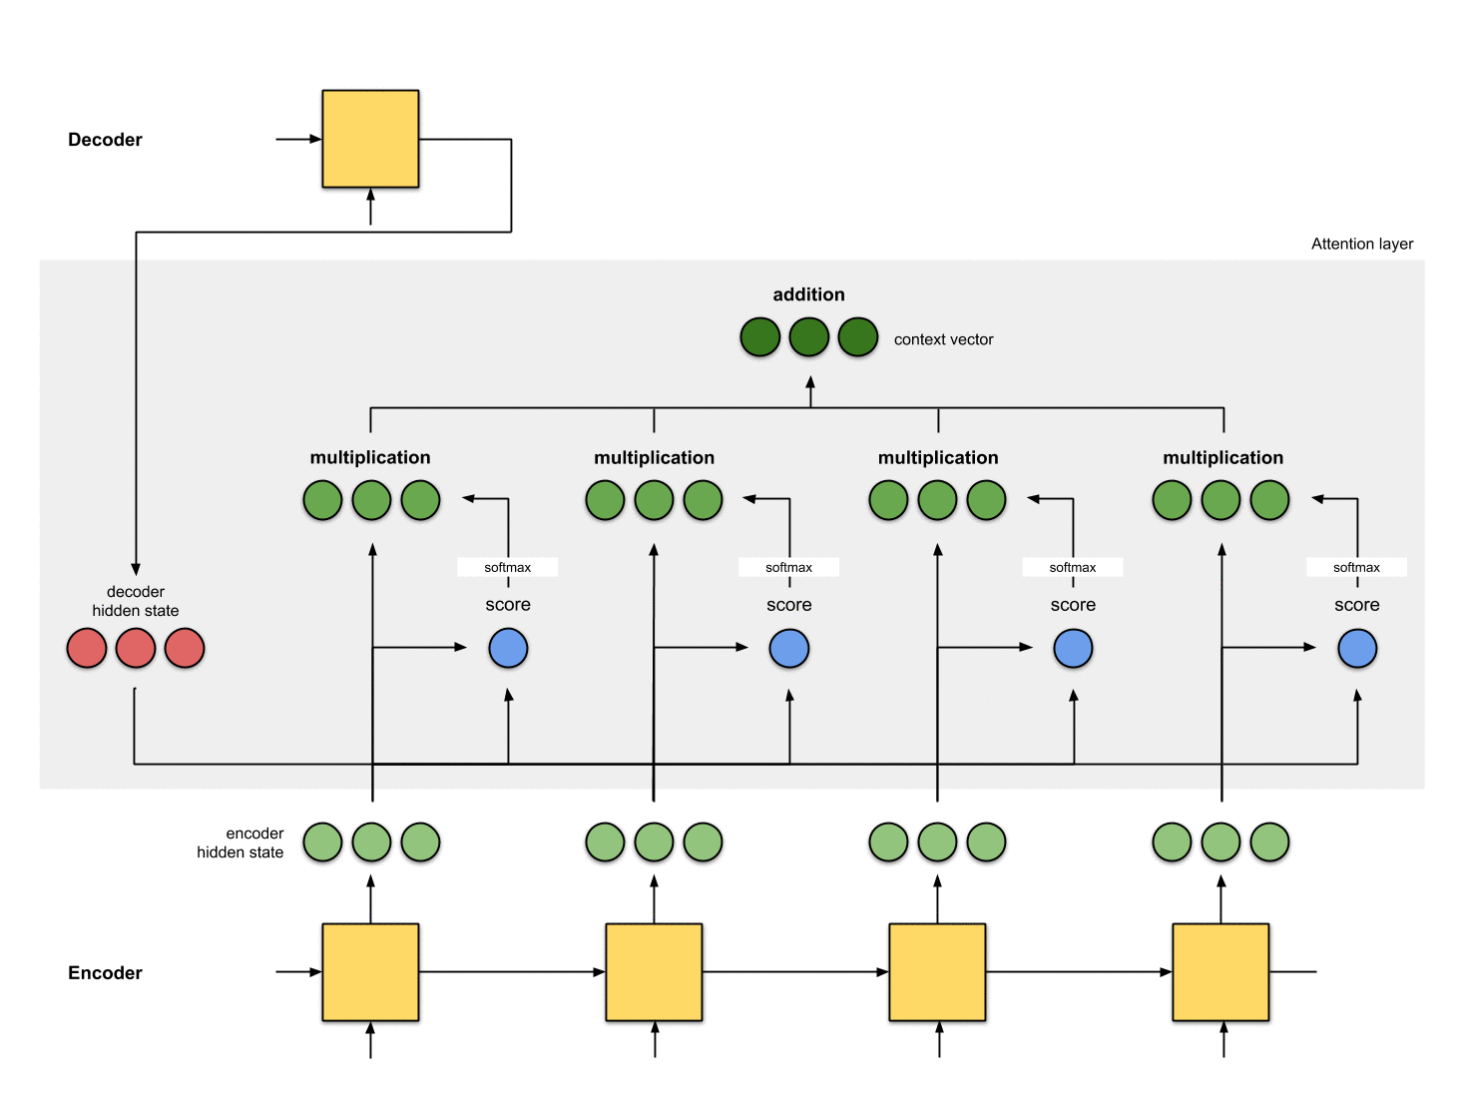

Slide 13
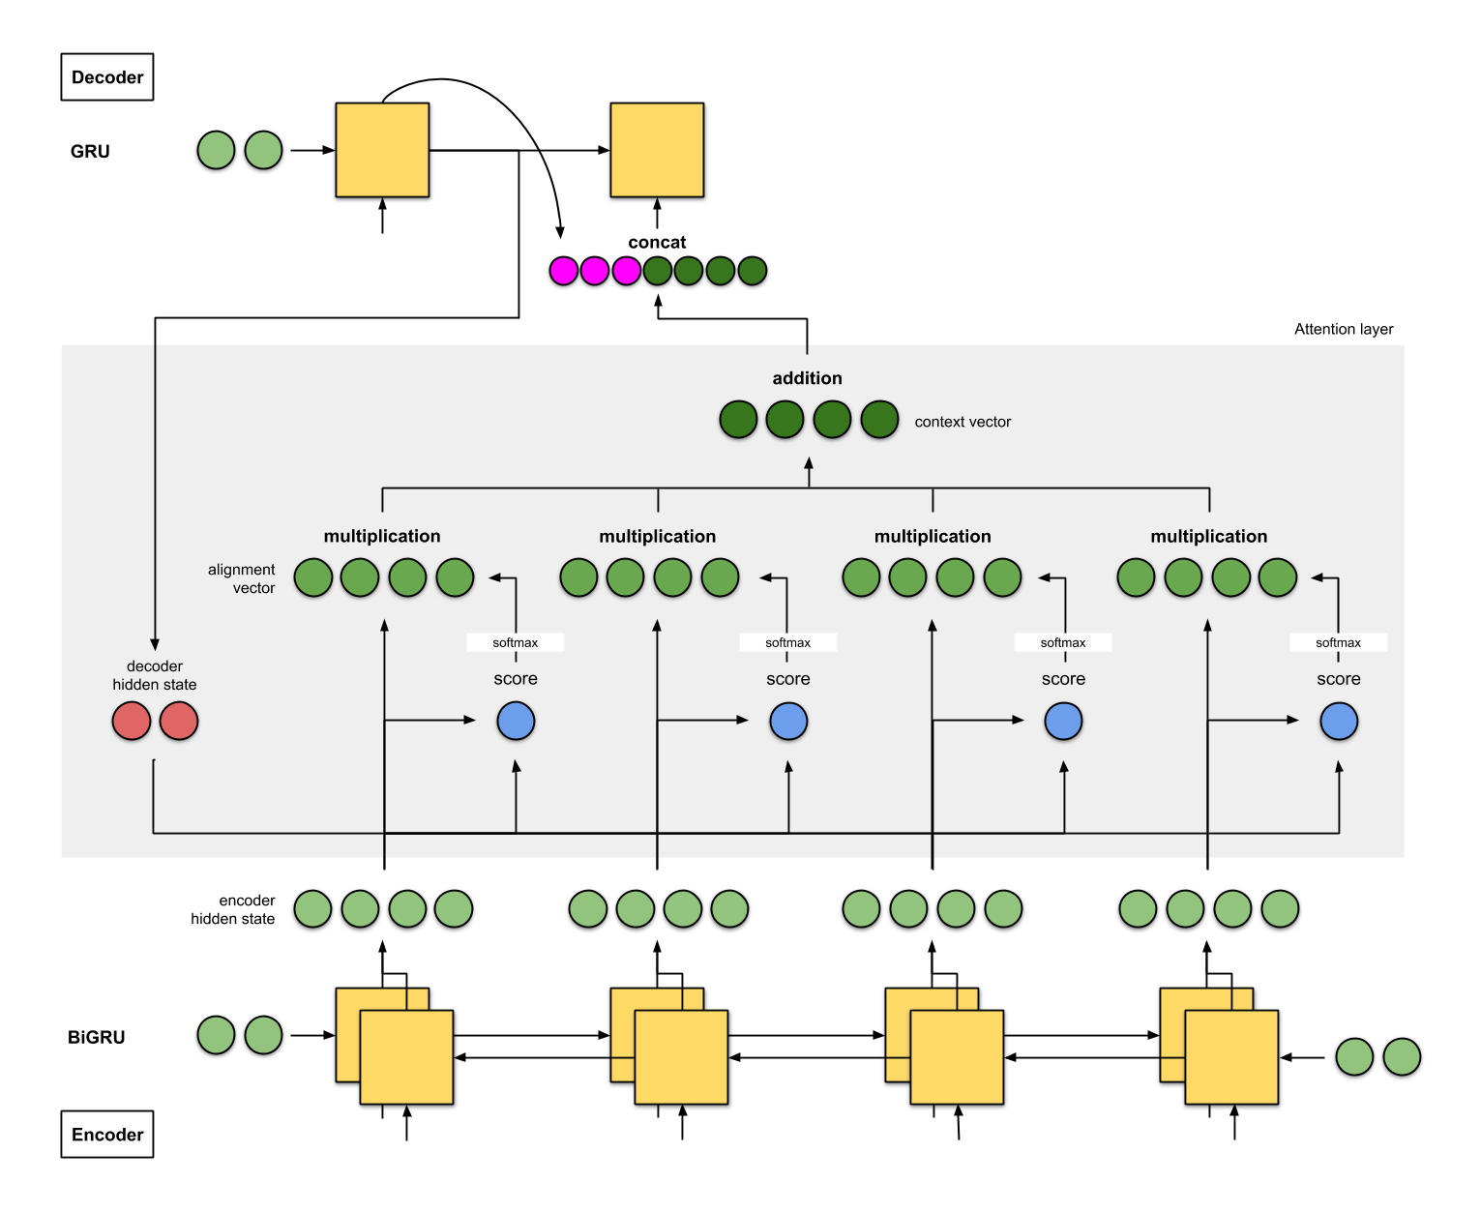
Additive
Bahdanau et. al 2014

Slide 14
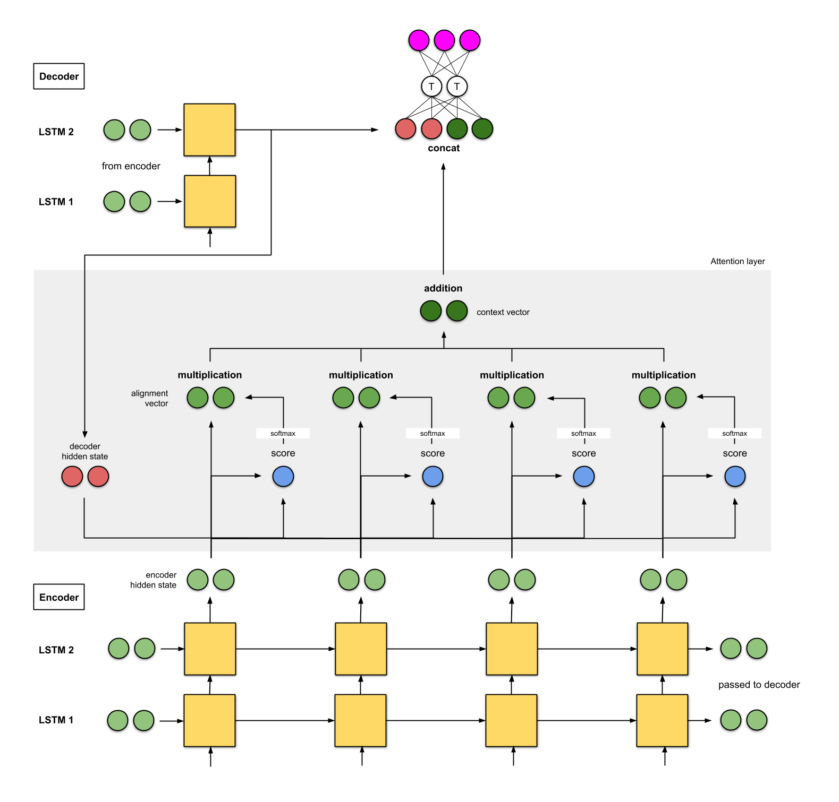
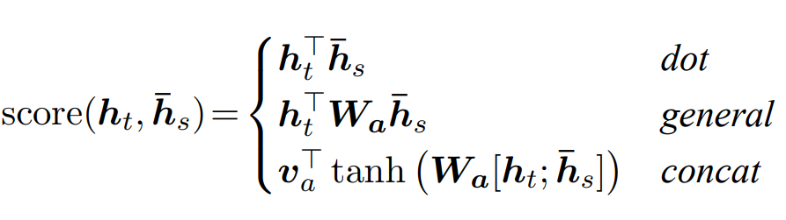
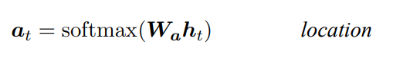
Local
Luong et. al 2015
There was a lot types of attention in paper study
General
Additive
Dot Product
Local

Slide 15
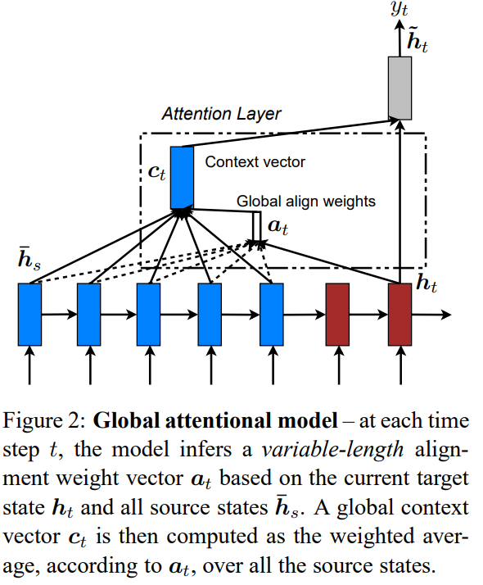
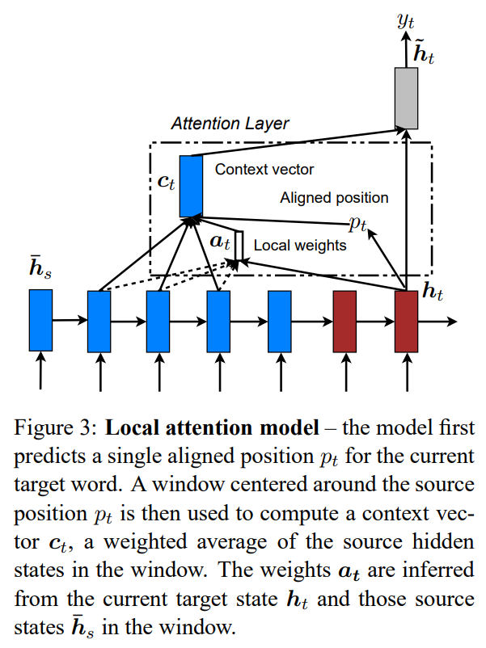

Slide 16
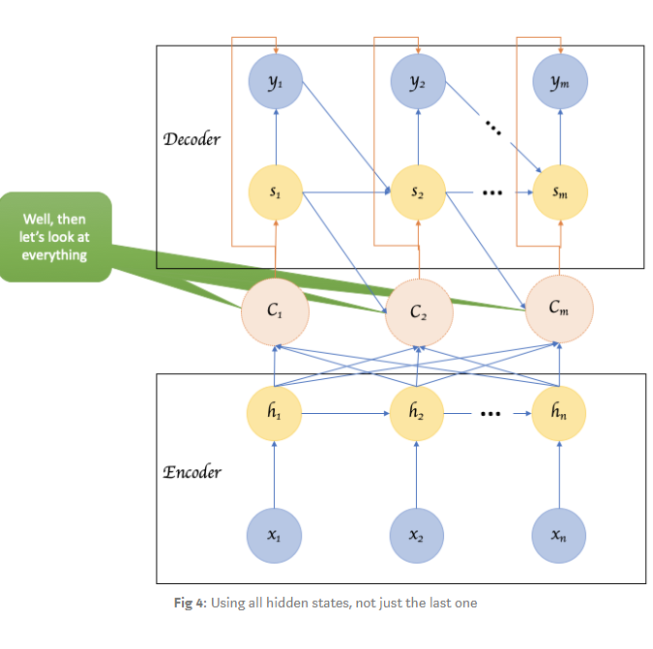

Slide 17
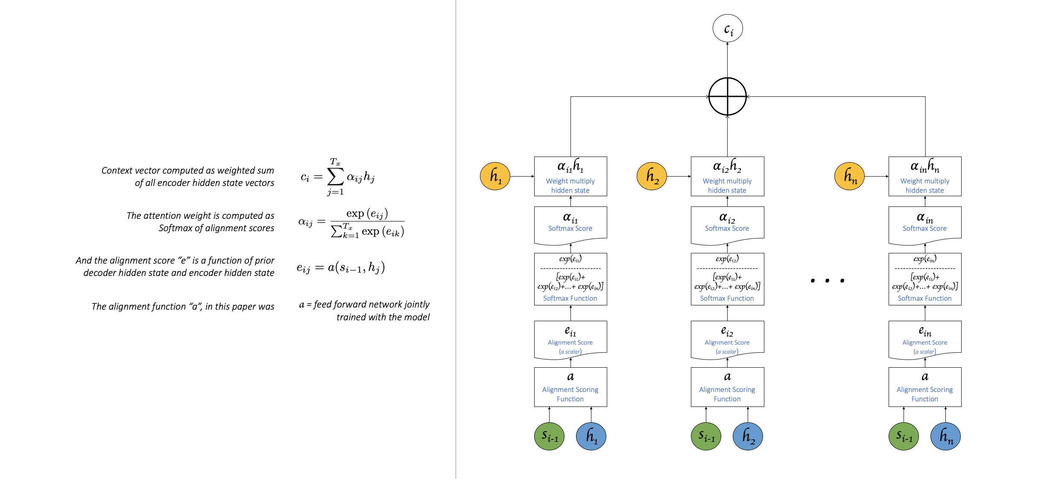

Slide 18
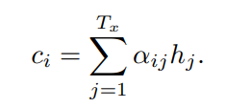
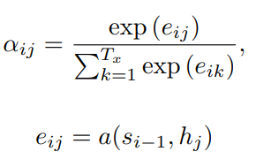
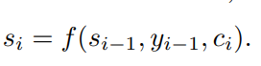
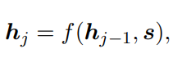
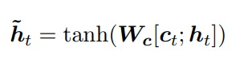
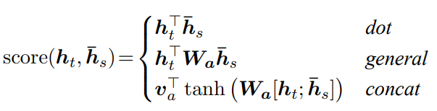
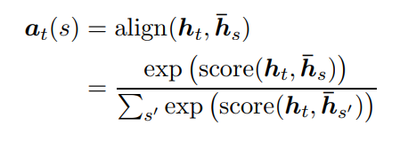
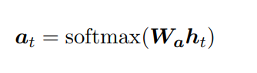
Formalization (one more time)
Alignment model
Local
Global

Slide 19
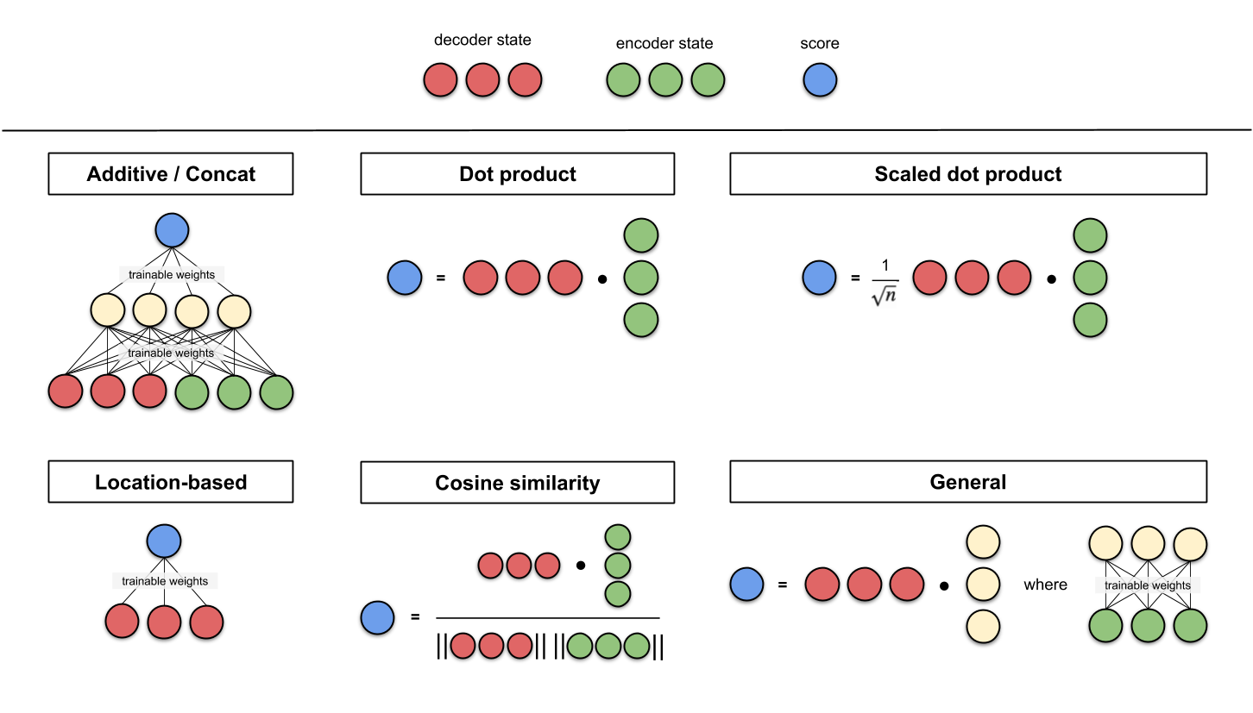
Summary again that pictures

Slide 20
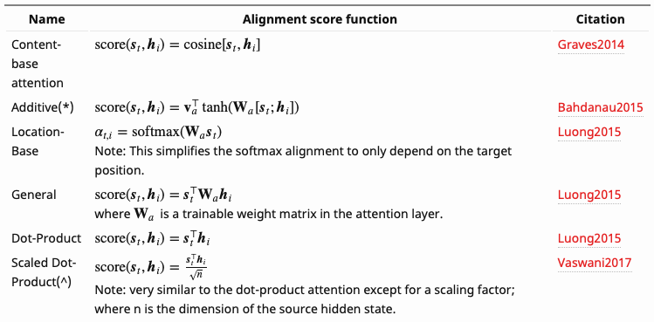
Summary again that pictures

Slide 21
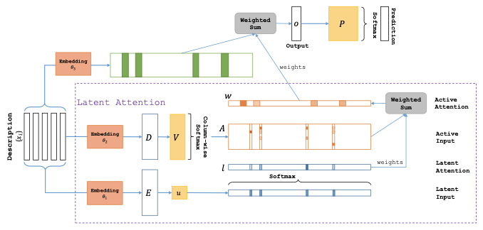
Latent attention
“Latent Attention” presented by Chen et al. in this paper

Slide 22
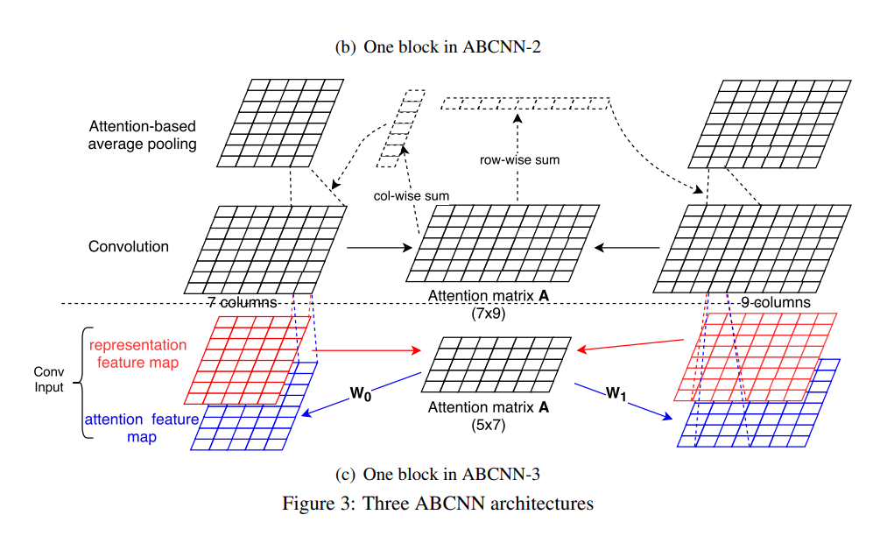
Attention Based CNN for sentences
ABCNN-3 in this paper

Slide 23
NAKONEC TO KARTINKI EPAT (images finally)
In paper
Show, Attend and Tell: Neural Image Caption Generation with Visual Attention
by Kelvin Xu et al 15
authors use img2seq model to caption images and they augmented it with … attention!
So how it was?

Slide 24
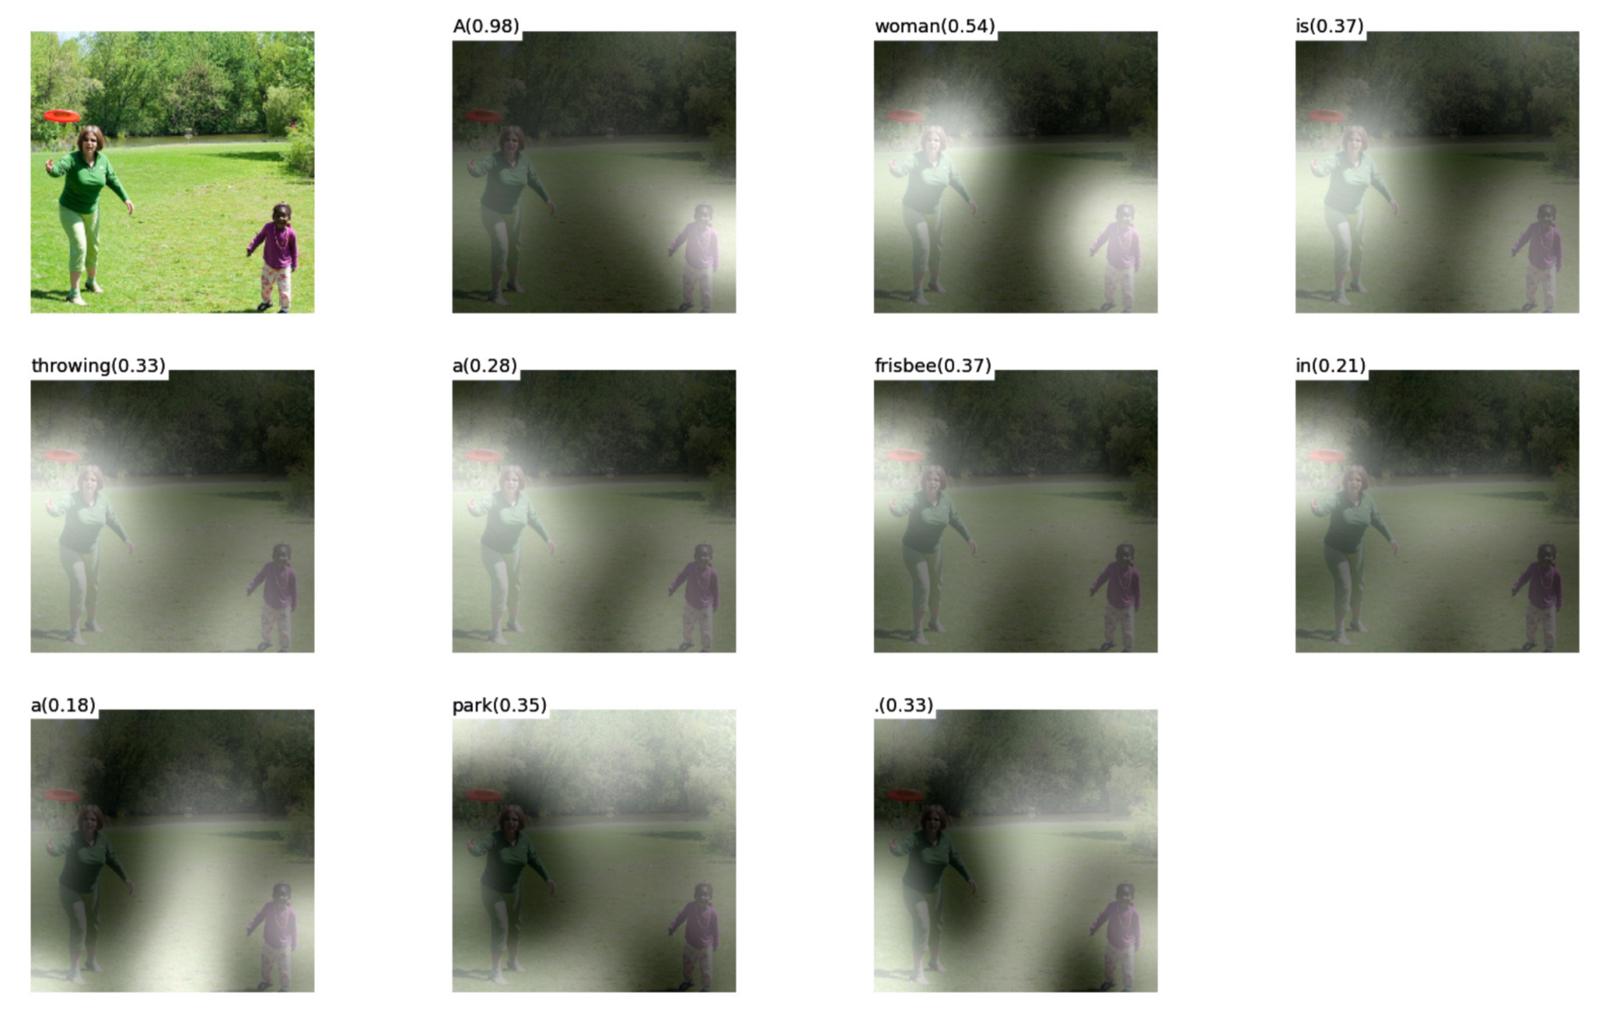
Soft/Hard (pic first!)
“A woman is throwing a frisbee in a park.” Xu et al. 2015

Slide 25
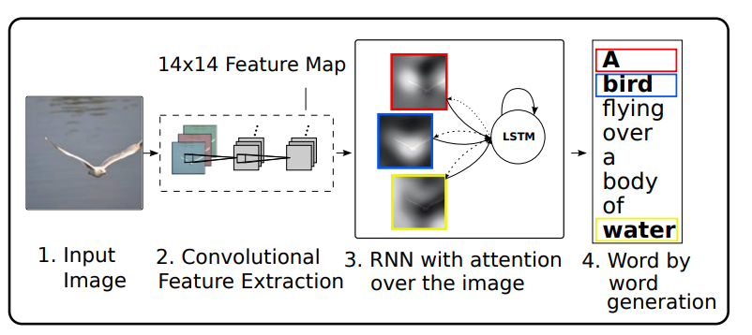
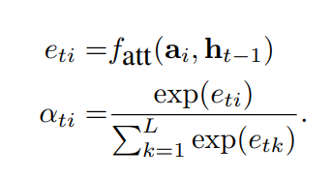
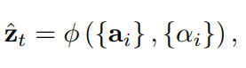
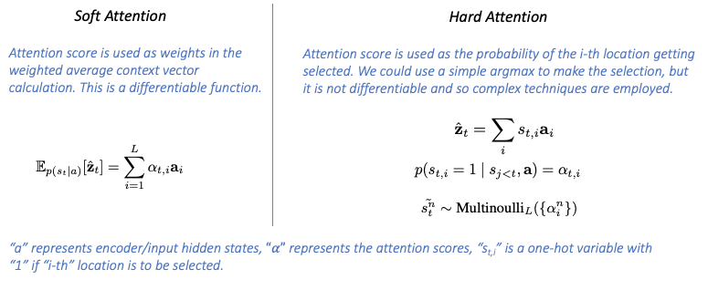
Soft/Hard

Slide 26
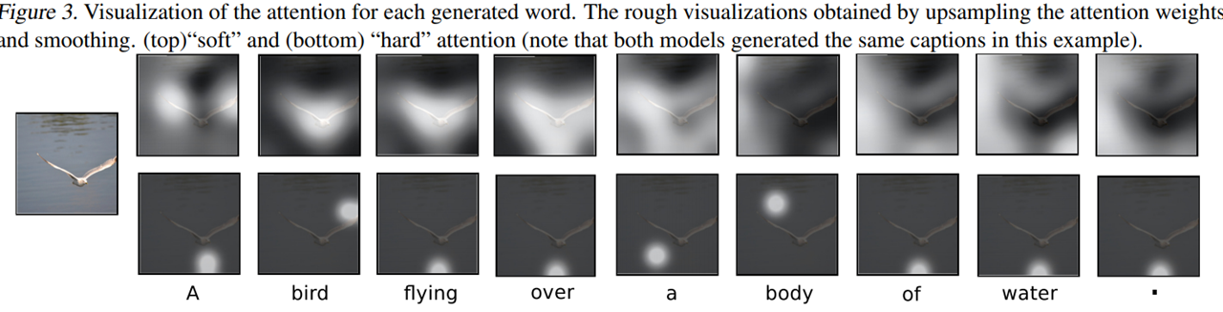
Soft/Hard

Slide 27
And there was many others that I decided not to tell you about… but next there was a game changer?

Slide 28
Self-Attention
Single, Multihead, Sparse, Huyars, Linear
Transformers, GANs, CNNs, Graphs
And other shit

Slide 29
Intra-Attention
Initially was introduced for machine reading and language modeling in paper
Long Short-Term Memory-Networks for Machine Reading
by Jianpeng Cheng et al 16

Slide 30
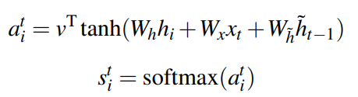
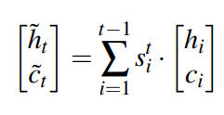
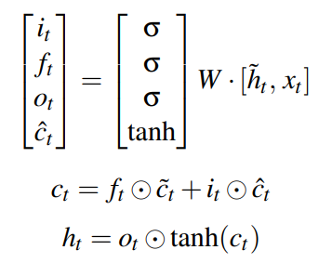
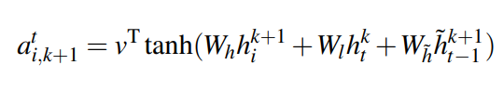
Intra-Attention
Something familiar in many ways?

Slide 31
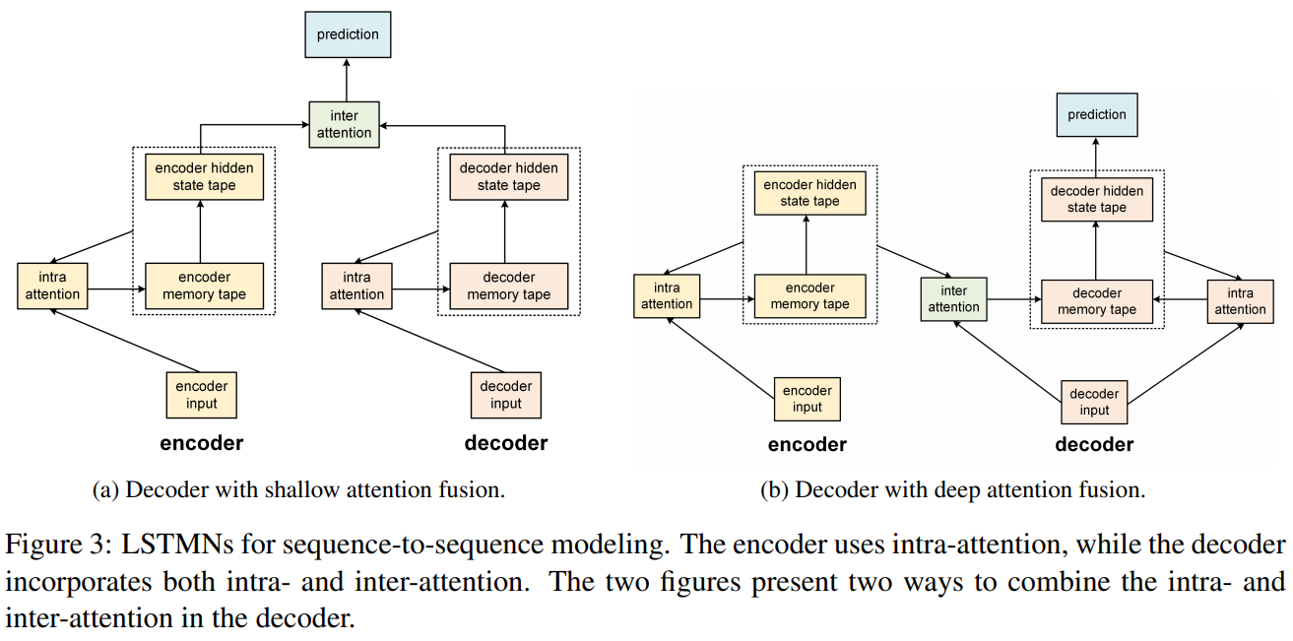
Intra-Attention

Slide 32
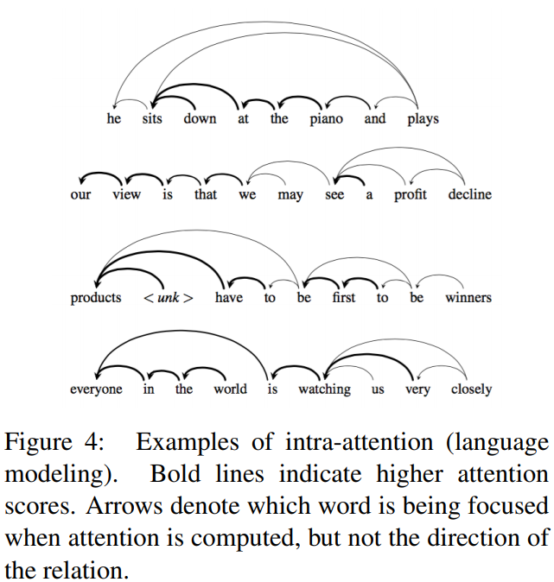
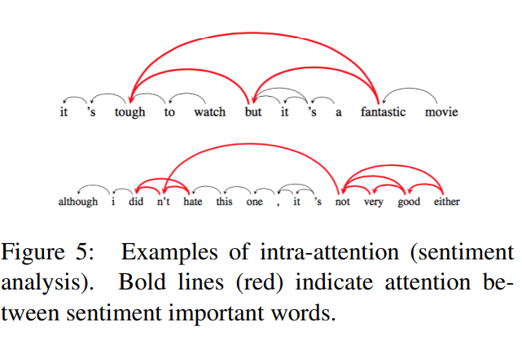
Intra-Attention

Slide 33
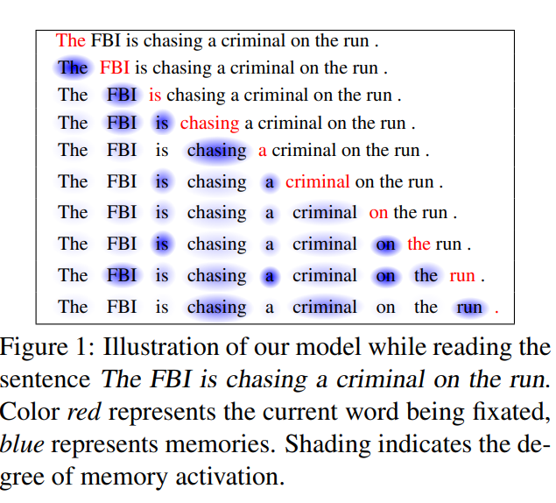
Intra-Attention

Slide 34
Self-Attention
ATTENTION IS ALL YOU NEED!!!111one
(You’ve been waiting that, right?)
Vaswani, et al., 2017

Slide 35
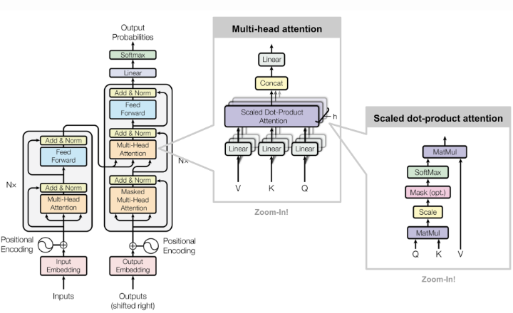
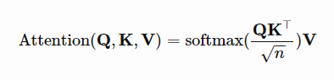
Self-Attention (Transformer)
Very much basenka
Key, Value, Query formalism
So Multihead
Easiest type of attention

Slide 36
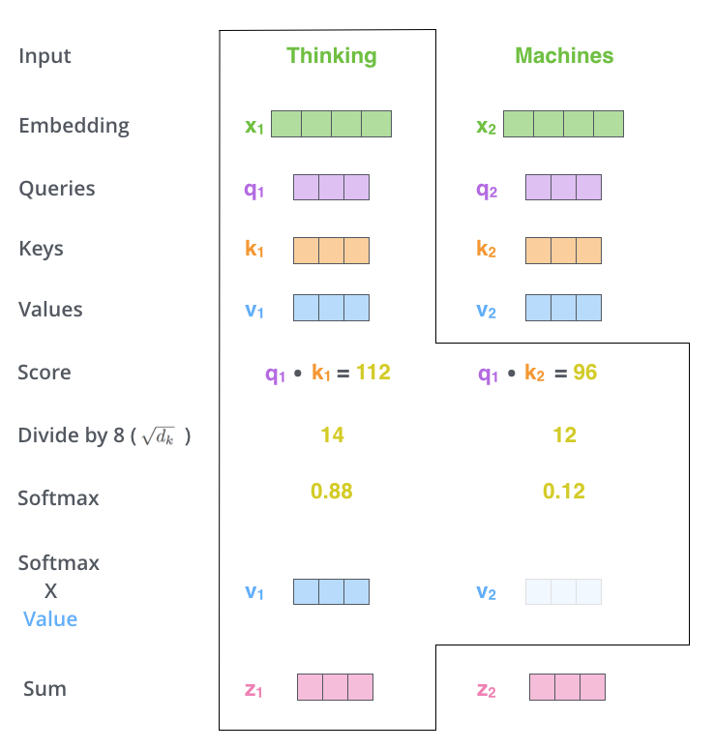
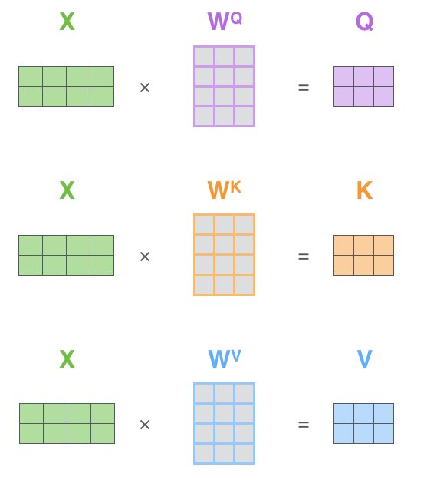
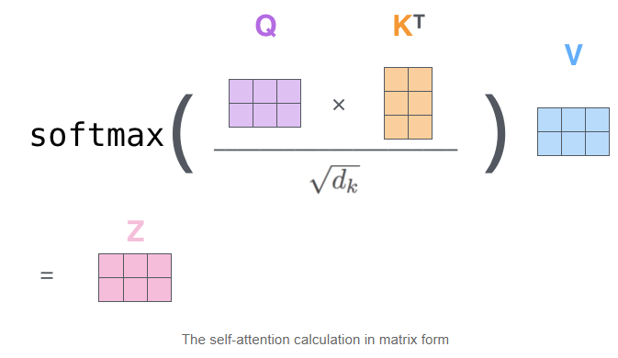
Les’t deep dive

Slide 37
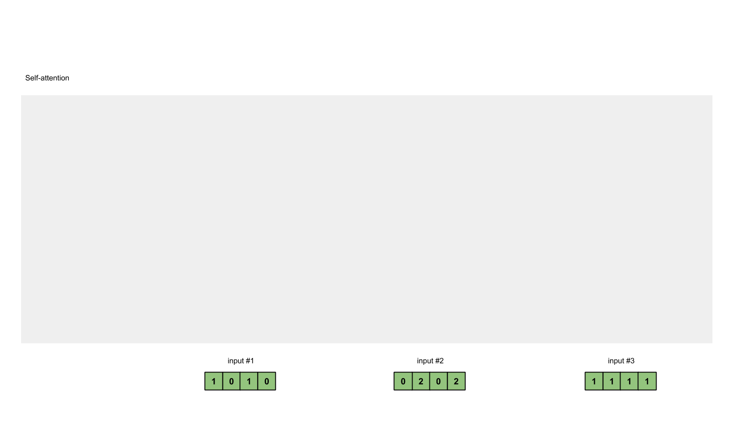
Les’t deep dive

Slide 38
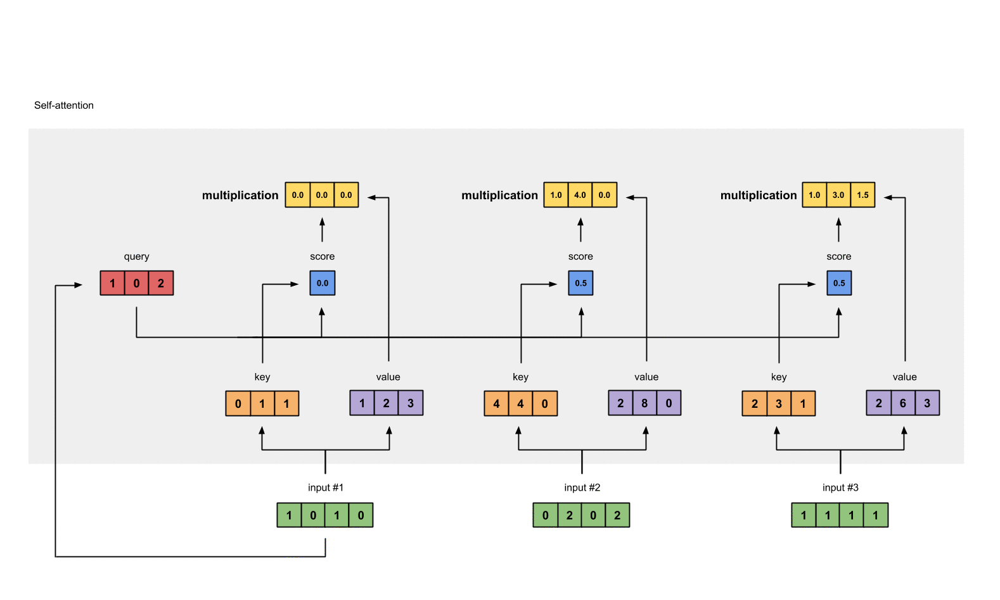
Les’t deep dive

Slide 39
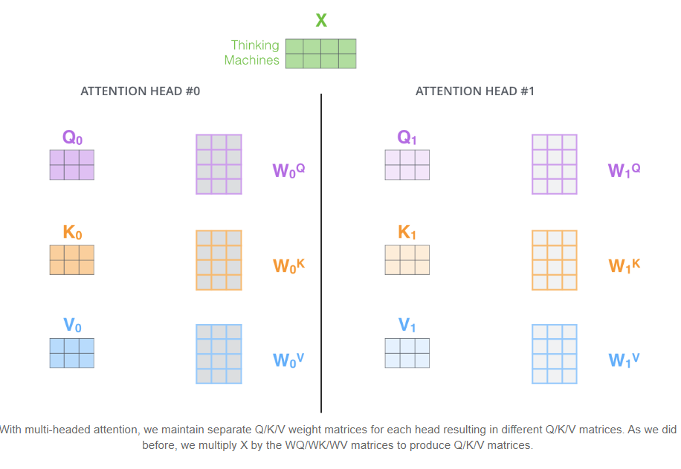
Les’t deep dive
Add some heads

Slide 40
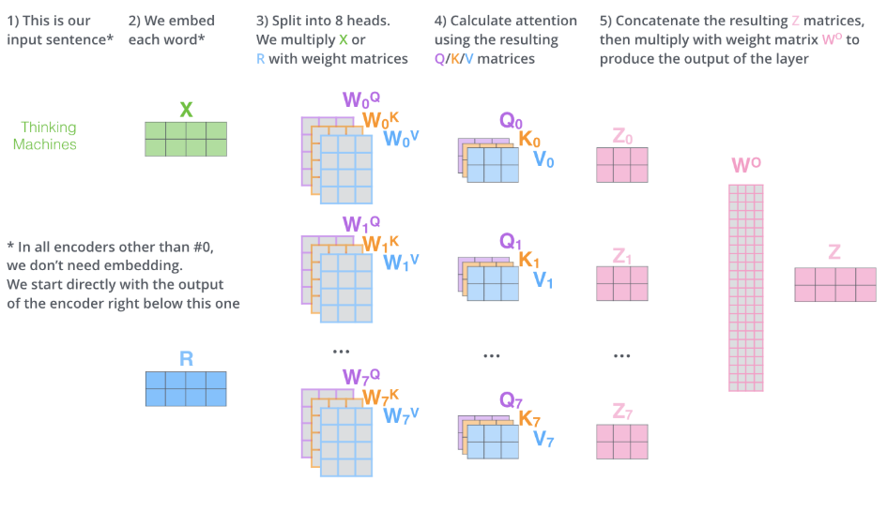
Les’t deep dive
Add some heads

Slide 41
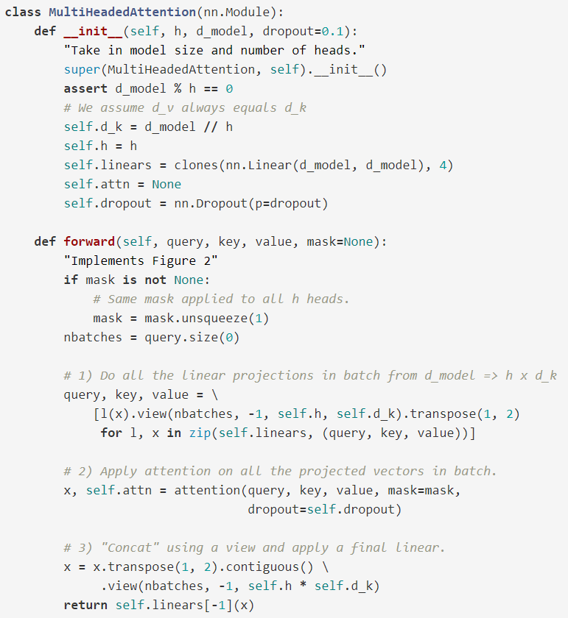
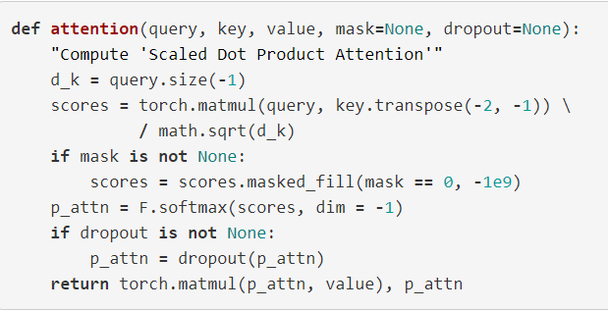
Self-Attention
Some code

Slide 42




Self-Attention with relation aware
In paper
Self-Attention with Relative Position Representations
by Peter Shaw at el 18 propose some kind of positional encoding in attention layer. The edge between input elements xi and xj is represented by vectors

Slide 43

Local Self-Attention (Images!)
In paper Image Transformer by Niki Parmar et al 18
They use transformer with local self-attention to produce images with super resolution task.

Slide 44

Self-Attention GAN (Images!)
Finally! The TRUE COMPUTER VISION.
SAGAN
Zhang et al., 2018

Slide 45



Self-Attention GAN (Images!)

Slide 46

Self-Attention GAN (Images!)
Scale parameter

Slide 47

Self-Attention GAN (Images!)

Slide 48


Simple Self-Attention (Images!)
SAGAN
Simple Self Attention)))
https://github.com/sdoria/SimpleSelfAttention

Slide 49
Modern Attention
It’s all about transformers of course!

Slide 50

Longer Attention Span (Transformer-XL)
Transformer-XL (Dai et al., 2019; “XL” means “extra long”)
A comparison between the training phrase of vanilla Transformer & Transformer-XL with a segment length 4.

Slide 51



Longer Attention Span (Transformer-XL)
The long attention span
And his positional encoding

Slide 52





Adaptive Attention Span Sukhbaatar, et al., (2019)
https://ai.facebook.com/blog/making-transformer-networks-simpler-and-more-efficient/

Slide 53

All-attention layer Sukhbaatar, et al., (2019)
https://ai.facebook.com/blog/making-transformer-networks-simpler-and-more-efficient/

Slide 54

Sparse Attention Matrix Factorization (Sparse Transformers) Child et al., 2019
aka factorized self-attention with O(sqrt(Т)) complexity
https://openai.com/blog/sparse-transformer/

Slide 56
Locality-Sensitive Hashing Attention (Reformer) Kitaev, et al. 2020
Вообще другая нахуй другая хуйня!
Replace the dot-product attention with locality-sensitive hashing (LSH) attention, reducing the complexity from O(L2²) to O(LlogL).
Replace the standard residual blocks with reversible residual layers, which allows storing activations only once during training instead of N times (i.e. proportional to the number of layers).

Slide 57



Locality-Sensitive Hashing Attention (Reformer) Kitaev, et al. 2020
Local Sensitive Hashing
Alrogythm

Slide 58

Locality-Sensitive Hashing Attention (Reformer) Kitaev, et al. 2020
Local Sensitive Hashing
Alrogythm

Slide 59





Locality-Sensitive Hashing Attention (Reformer) Kitaev, et al. 2020
locality-sensitive hashing
S_{i} = P_{i}

Slide 60
Locality-Sensitive Hashing Attention (Reformer) Kitaev, et al. 2020
(a) The attention matrix for full attention is often sparse.
(b) Using LSH, we can sort the keys and queries to be aligned according to their hash buckets.
(c) Set Q=KQ=K (precisely kj=qj/∥qj∥kj=qj/‖qj‖), so that there are equal numbers of keys and queries in one bucket, easier for batching. Interestingly, this “shared-QK” config does not affect the performance of the Transformer.
(d) Apply batching where chunks of mm consecutive queries are grouped together.

Slide 61

Locality-Sensitive Hashing Attention (Reformer) Kitaev, et al. 2020

Slide 62


Locality-Sensitive Hashing Attention (Reformer) Kitaev, et al. 2020
Reversible Residual Network

Slide 63
To be continued…
Cause there is an attention in detection
Cause there is attention in graphs
Cause there is attention in 3d
Cause there is some theoretical evidence of relation between Attention and CNN and Graphs and Oh boy..

Slide 64
Desecrated links
https://lilianweng.github.io/lil-log/2018/06/24/attention-attention.html
https://lilianweng.github.io/lil-log/2020/04/07/the-transformer-family.html
http://nlp.seas.harvard.edu/2018/04/03/attention.html
http://jalammar.github.io/illustrated-transformer/
https://towardsdatascience.com/attention-in-neural-networks-e66920838742
https://towardsdatascience.com/illustrated-self-attention-2d627e33b20a
https://towardsdatascience.com/attn-illustrated-attention-5ec4ad276ee3#ba24

